Slide 1
SEARCHING and SORTING TECHNIQUES (Complexity Analysis) WINNING CAMP 2023

Slide 2
INDEX
COMPLEXITY ANALYSIS OF:
LINEAR SEARCH
BINARY SEARCH
JUMP SEARCH
FIBBONACCI SEARCH
INTERPOLATION
EXPONENTIAL
MERGE SORT
QUICK SORT
SHELL SORT
COUNT SORT
CYCLE SORT
HEAP SORT

Slide 3
why we need to calculate the performance of an algorithm?
Consider two programmers “A” and “B”. Both of them submits 2 different solutions for the same program. Now how do we decide which solution is efficient and performs better?
And also A’s program might perform better for small number of input but will not perform when the input size increases.
Similarly, B’s program will not perform when the input size is small but will perform better for large number of input.
Hence to determine which of the solution is better, we take a look at two important factors that decide the performance of an algorithm:
1. Time complexity
2. Space Complexity

Slide 4
Asymptotic Analysis
Asymptotic analysis of an algorithm refers to defining the mathematical boundation /framing of its run-time performance. Using asymptotic analysis, we can very well conclude the best case, average case, and worst case scenario of an algorithm.
Asymptotic analysis refers to computing the running time of any operation in mathematical units of computation.
For example, the running time of one operation is computed as f(n) and may be for another operation it is computed as g(n²). This means the first operation running time will increase linearly with the increase in n and the running time of the second operation will increase exponentially when n increases.
Usually, the time required by an algorithm falls under three types −
Best Case − Minimum time required for program execution.
Average Case − Average time required for program execution.
Worst Case − Maximum time required for program execution.

Slide 5
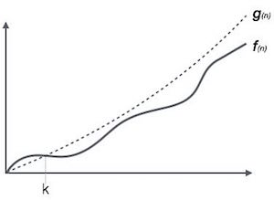
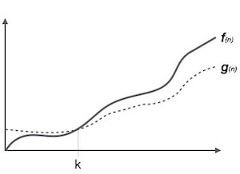
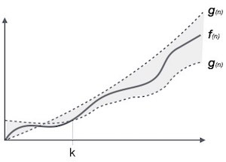
Asymptotic Notations
Big Oh Notation, Ο
The notation Ο(n) is the formal way to express the upper bound of an algorithm's running time. It measures the worst case time complexity or the longest amount of time an algorithm can possibly take to complete.
Omega Notation, Ω
The notation Ω(n) is the formal way to express the lower bound of an algorithm's running time. It measures the best case time complexity or the best amount of time an algorithm can possibly take to complete.
Theta Notation, θ
The notation θ(n) is the formal way to express both the lower bound and the upper bound of an algorithm's running time.

Slide 6
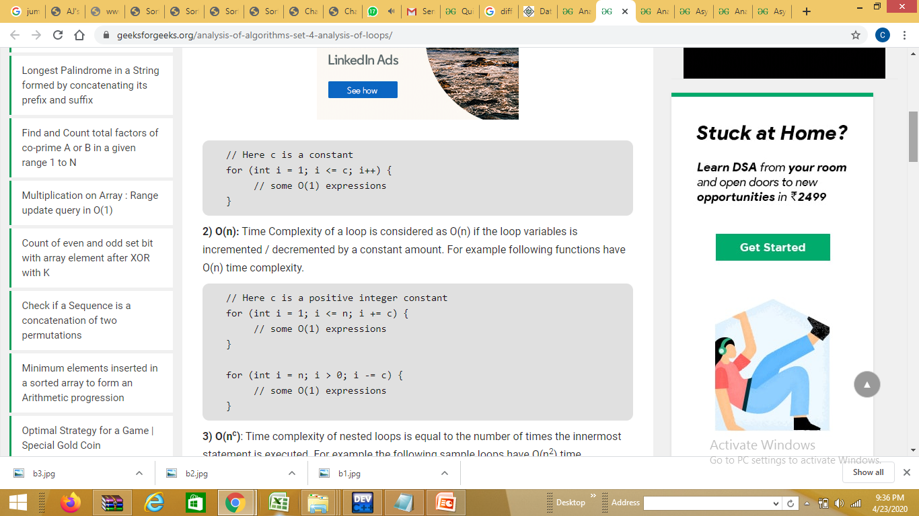
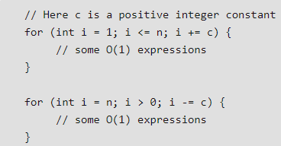
Analysis of Algorithms
1. O(1): Time complexity of a function (or set of statements) is considered as O(1) if it doesn’t contain loop, recursion and call to any other non-constant time function.
// set of non-recursive and non-loop statements
For example has O(1) time complexity. swap() function A loop or recursion that runs a constant number of times is also considered as O(1).
2. O(n): Time Complexity of a loop is considered as O(n) if the loop variables is incremented / decremented by a constant amount. For example following functions have O(n) time complexity.

Slide 7
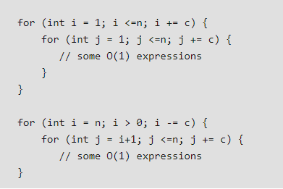
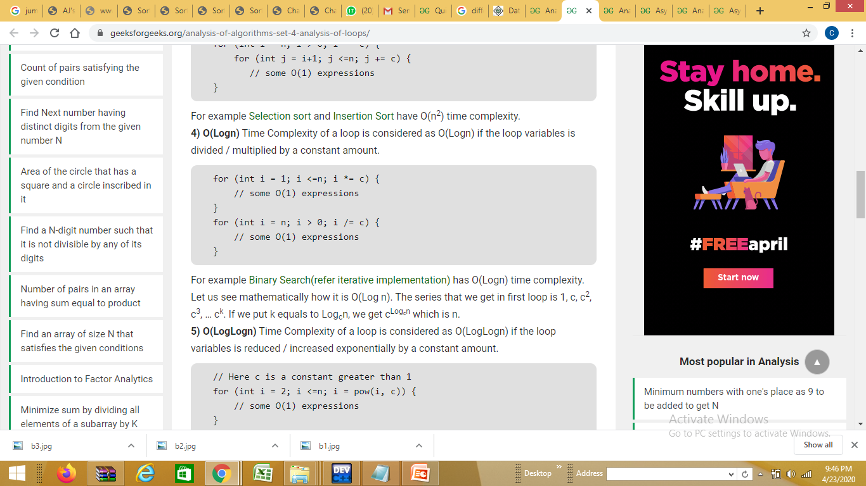
Analysis of Algorithms
O(n^{c}): Time complexity of nested loops is equal to the number of times the innermost statement is executed. For example the following sample loops have O(n²) time complexity.
For example Selection sort and Insertion Sort have O(n²) time complexity.
4. O(Logn) Time Complexity of a loop is considered as O(Logn) if the loop variables is divided / multiplied by a constant amount.
For example Binary Search (refer iterative implementation) has O(Logn) time complexity.

Slide 8
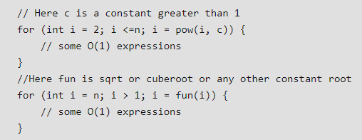
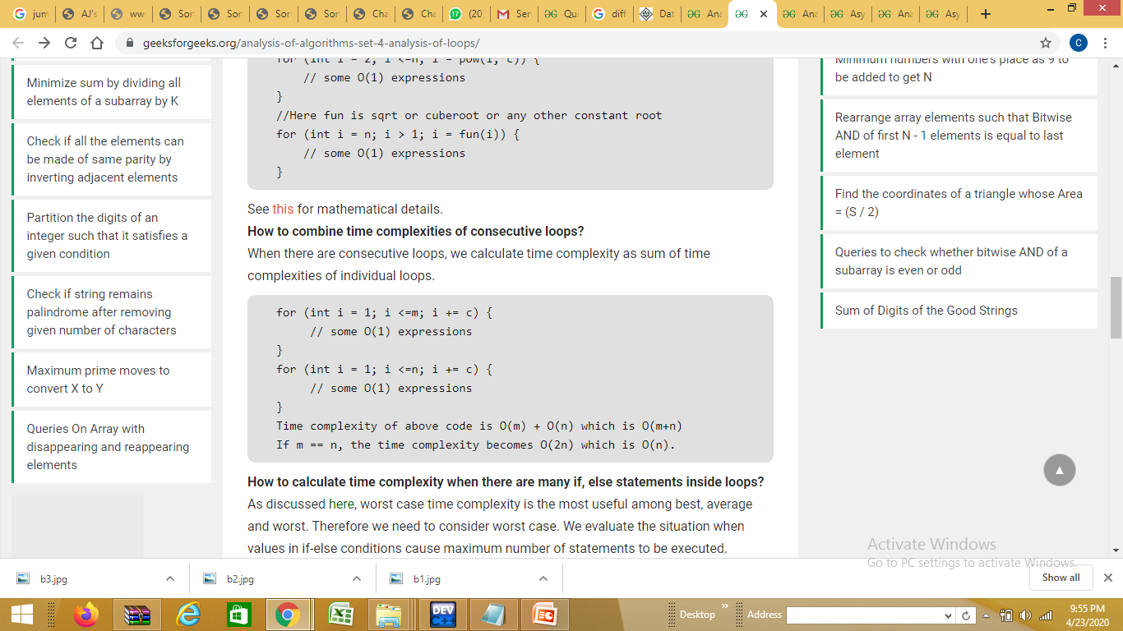
Analysis of Algorithms
5. O(LogLogn) Time Complexity of a loop is considered as O(LogLogn) if the loop variables is reduced / increased exponentially by a constant amount.
When there are consecutive loops, we calculate time complexity as sum of time complexities of individual loops.

Slide 9
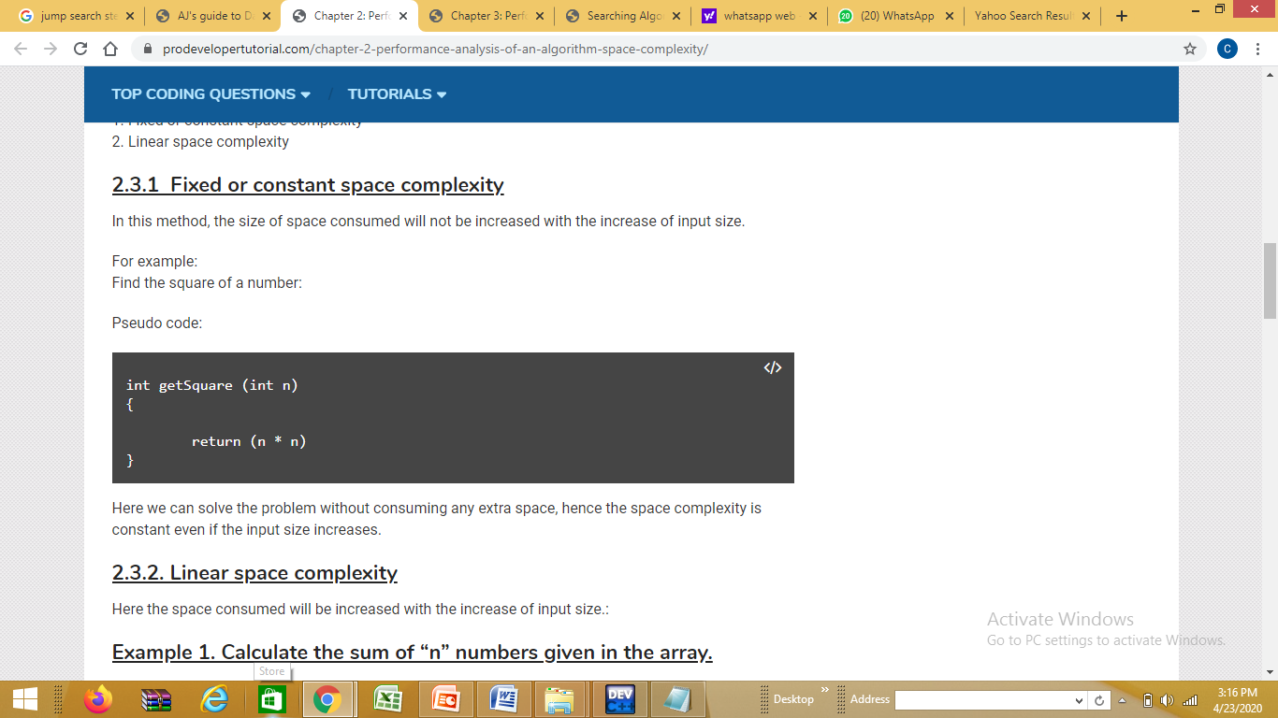
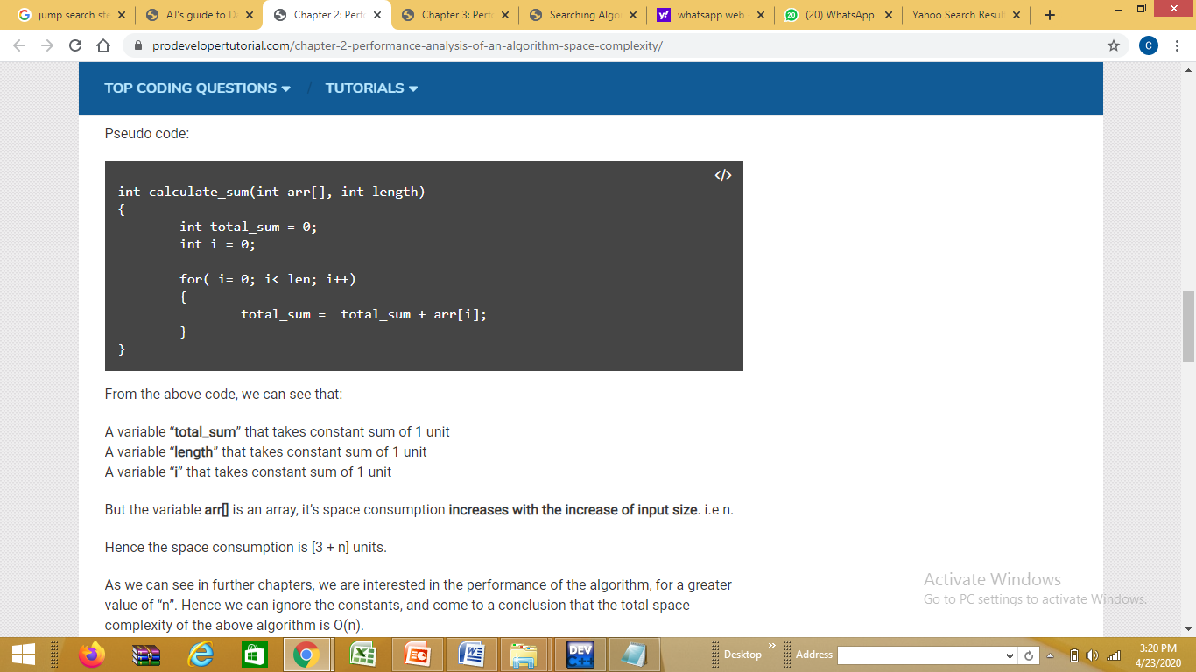
Space Complexity
Space complexity can be broadly classified into 2 types.
1. Fixed or constant space complexity
2. Linear space complexity
Here the space consumed will be increased with the increase of input size
Calculate the sum of “n” numbers given in the array.

Slide 10
LINEAR SEARCH COMPLEXITY
A linear search runs in at worst linear time and makes at most n comparisons, where n is the length of the list.
A linear search scans one item at a time, without jumping to any item . The worst case complexity is O(n), sometimes known an O(n) search.
Class (Linear Search) | Search algorithm
Worst-case performance | O(n)
Best-case performance | O(1)
Average performance | O(n)
Worst-case space complexity | O(1) iterative

Slide 11
Binary Search complexity
Binary search runs in at worst logarithmic time , making O(log n) comparisons, where n is the number of elements in the array, the O is Big O notation , and log is the logarithm .
Binary search takes constant (O(1)) space, meaning that the space taken by the algorithm is the same for any number of elements in the array.
Binary Search | Complexity
Average complexity | O(log n)
Best complexity | O(1)
Worst complexity | O(log n)
Space complexity | O(1)

Slide 12
INTERPOLATION SEARCH: COMPLEXITY
It is a modified algorithm of Binary search reducing the complexity.
Best/Average case complexity is O(log log n) ) which will occur when elements of the array are fairly uniformly distributed over their interval eg. . [3,5,8,10,13,15]
Worst case complexity is O(n) which will occur when the elements are not fairly uniformly distributed over their interval eg. [3,5,8,12,13,100]
However, its average case complexity, under the assumption that the keys are uniformly distributed, is O(log log N).
Interpolation Search | Complexity
Average complexity | O(log₂(log ₂n))
Best complexity | O(log₂(log ₂n))
Worst complexity | O(n)
Space complexity | O(1)
Refer to slide 28, 29 to understand O(log log N) Complexity

Slide 13
Jump Search Complexity
This algorithm works only for sorted input arrays
Optimal size of the block to be skipped is √n, thus resulting in the time complexity O(√n²)
The time complexity of this algorithm lies in between linear search (O(n)) and binary search (O(log n))
It is also called block search algorithm.
Jump Search | Complexity
Best case time complexity | O(√N)
Average case time complexity | O(√N)
Worst case time complexity | O(1)
Space complexity | O(1)

Slide 14
EXPONENTIAL SEARCH COMPLEXITY
Time Complexity: O(1) for the best case. O(log ₂i) for average or worst case. Where i is the location where search key is present.
EXPONENTIAL SEARCH | Complexity
Best-case performance‎ | O(1)
Worst-case performance‎ ‎ | O(log ₂i)
Average performance‎ | O(log ₂i)
Worst-case space complexity‎ ‎ | O(1)

Slide 15
FIBONACCI SEARCH COMPLEXITY
Fibonacci search is an efficient search algorithm based on divide and conquer principle that can find an element in the given sorted array with the help of Fibonacci series in O(log N) time complexity.
This is based on Fibonacci series which is an infinite sequence of numbers denoting a pattern.
FIBONACCI SEARCH | Complexity Notation
Best case time complexity | O(1)
Average case time complexity | O(1)
Worst case time complexity | O(log n)
Average space complexity | O(1)

Slide 16
COMPLEXITY ANALYSIS OF SORTING ALGORITHMS

Slide 17
MERGE SORT COMPLEXITY
Merge sort is a sorting technique based on divide and conquer technique.
With worst- case time complexity being Ο(n log n)
Merge sort first divides the array into equal halves and then combines them in a sorted manner.
MERGE SORT | Complexity Notation
Best-case performance‎ | nlog(n)
Worst-case performance‎ ‎ | nlog(n)
Average performance‎ | nlog(n)
Worst-case space complexity‎ ‎ | n

Slide 18
Quick sort
Quick Sort is sensitive to the order of input data.
It gives the worst performance when elements are already in the ascending order.
It then divides the array into sections of 1 and (n-1) elements in each call. Then, there are (n-1) divisions in all.
Therefore, here total comparisons required are f(n) = n x (n-1) = O(n²).
Quick Sort | Complexity Notation
Best complexity | O(nlog(n))
Average complexity | O(nlog(n))
Worst complexity | O(n ²)
Space complexity | O(1)

Slide 19
Count sort complexity
The space complexity of Counting Sort is O(max). Larger the range of elements, larger is the space complexity.
Counting sort is used when:
there are smaller integers with multiple counts.
linear complexity is the need.
Count Sort | Complexity Notation
Best Case Complexity | O(n+k)
Average Case Complexity | O(n+k)
Worst Case Complexity | O(n+k)
Space Complexity | O(n+k)

Slide 20
Shell sort complexity
The complexity depends on the interval chosen. The complexities differ for different increment sequences chosen. Best increment sequence is unknown.
Shell sort is an unstable sorting algorithm because this algorithm does not examine the elements lying in between the intervals.
Shell Sort | Complexity Notation
Best Case Complexity | O(nlog n)
Average Case Complexity | O(nlog n)
Worst Case Complexity | O(n²)
Space Complexity | O(1)

Slide 21
Heap sort complexity
Running time: after n iterations the Heap is empty
Every iteration involves a swap and a max_heapify operation; hence it takes O(log n) time Overall O(n log n)
Heap sort is not a Stable sort, and requires a constant space for sorting a list.
Heap Sort | Complexity Notation
Best Case Time Complexity | O(nlog n)
Average Time Complexity | O(nlog n)
Worst Case Time Complexity | O(nlog n)
Space Complexity | O(1)

Slide 22
Cycle Sort Complexity
Cycle Sort is an in-place sorting algorithm. It is also a comparison based sort and efficient for any other in-place sorting technique. It finds the minimum number of memory write to perform the sorting tasks.
This sorting algorithm is best suited for situations where memory write or swap operations are costly.
Cycle sort | Complexity Notation
Best Case Time Complexity | O(n ²)
Average Time Complexity | O(n ²)
Worst Case Time Complexity | O(n ²)
Space Complexity | O(1)

Slide 23
Some Important NOTES
Notaions
logN: The running time is logarithmic. Algorithms like binary search.
N: The running time is linear. Algorithms like linear search.
NlogN: The algorithm like quick sort and merge sort.
N²: The running time is quadratic. They usually will be having 2 loops. Algorithms like: Bubble sort, selection sort.
2^{n} : The running time is exponential.
Why we ignore constants while calculating the complexity of algorithms?
1. When we have a time complexity of “O(n ²+ 3)”, we ignore the constant “3”, and find the total time complexity as “O(n ²)”.
This is because, we always want to know how the algorithm will perform for a larger value of “n”. For example, if the value of “n” is “10000”, then the constant “3” will be negligible. Hence we ignore it.
2. When we have a time complexity of “O(3 n ² )
we ignore the constant “3” and final time complexity will be “O(n ²)
This is because, different computer architecture will be having different ways to handle the constant “3”. A faster computer will be able to store the constant in the register and is able to access it faster. A slower computer will hold it in memory hence is slower. As we are interested no the algorithm performs not on how the hardware performs, we ignore that constant.

Slide 24
Questions??
Q1: What is the time complexity of Fibonacci Search?
Ans: O(logn)
Q2: What is the time complexity of Jump Search?
Ans: O(sqrt(n))
Q3:What is the complexities Exponential search has?
Ans: neither an exponential space complexity nor exponential time complexity.

Slide 25
Questions??
Q4 :In which of the following case jump search will be preferred over binary search?
Ans: jumping backwards takes significantly more time than jumping forward
Q5: What is the auxiliary space requirement of the exponential sort when used with recursive binary search?
Ans: O(log n)
Q6: What is the complexity of interpolation search?
Ans: The Interpolation Search is an improvement over Binary Search for instances, where the values in a sorted array are uniformly distributed.
Q7. What is Worst Case Time Complexity of heap sort
Ans: O(n*log n)

Slide 26
Questions??
Q8. Time complexity of cycle sort
Ans: O(n^2)
Q9. The space complexity for shell sort is
Ans: O(1)

Slide 27
Further Reading

Slide 28
Case 1
Time Complexity of a Loop when Loop variable “Expands or Shrinks” exponentially
For such cases, time complexity of the loop is O(log(log(n))). The following cases analyze different aspects of the problem.
In this case, i takes values 2, 2^{k}, (2^{k})^{k} = 2^{k2}, (2^{k2})^{k} = 2^{k3}, …, 2^{klog}_{k}^{(log(n))}.
The last term must be less than or equal to n, and we have 2^{klog}_{k}^{(log(n))} = 2^{log(n)} = n, which completely agrees with the value of our last term.
So there are in total log_{k}(log(n)) many iterations, and each iteration takes a constant amount of time to run, therefore the total time complexity is O(log(log(n)))
for (int i = 2; i <=n; i = pow(i, k))
{
// some O(1) expressions or statements
}

Slide 29
Case 2
// func() is any constant root function
for (int i = n; i > 1; i = func(i))
{
// some O(1) expressions or statements
}
In this case, i takes values n, n^{1/k}, (n^{1/k})^{1/k} = n^{1/k2}, n^{1/k3}, …, n^{1/klog}_{k}^{(log(n))}, so there are in total log_{k}(log(n)) iterations and each iteration takes time O(1),
so the total time complexity is O(log(log(n))

Slide 30
References
Data Structures and Algorithms Made Easy in Java: Data Structure and Algorithmic Puzzles” by Narasimha Karumanchi
Data Structures and Algorithms in Java” by Lafore
“Data Structures and Algorithms for GATE: Solutions to All Previous GATE Questions Since 1991” by Narasimha Karumanchi
https://www3.ntu.edu.sg/home/ehchua/programming/cpp/DataStructureAlgorithm.html
https://www.geeksforgeeks.org/data-structures/
https://www.geeksforgeeks.org/analysis-of-algorithms-set-4-analysis-of-loops/

